Slide 1
ADD PRACTICAL

Slide 2
What is DDL?
Data Definition Language helps you to define the database structure or schema. DDL commands help you to create the structure of the database and the other database objects. Its commands are auto-committed so, the changes are saved in the database permanently. The full form of DDL is Data Definition Language.

Slide 3
What is DML?
DML commands it to allow you to manage the data stored in the database, although DML commands are not auto-committed. Moreover, they are not permanent. So, It is possible to roll back the operation. The full form of DML is Data Manipulation Language.
Below is the key difference between DDL and DML in DBMS:
KEY DIFFERENCES:
Data Definition Language (DDL) helps you to define the database structure or schema while Data Manipulation language (DML command) allows you to manage the data stored in the database.
DDL command is used to create the database schema while DML command is used to populate and manipulate database
Comparing DDL vs DML, DDL statements affect the whole table whereas DML commands only affect one or more rows.
In DDL, SQL Statement can’t be rollbacked while in DML SQL Statement can be a rollbacked.
DDL is a declarative method while DML is an imperative method.
Important DDL commands are: 1) CREATE, 2) ALTER, 3) DROP, 4) TRUNCATE, etc. while important DML commands are: 1) INSERT, 2) UPDATE, 3) DELETE, 4) MERGE, etc.

Slide 4
Why DDL?
Here, are reasons for using DDL method:
Allows you to store shared data
Data independence improved integrity
Allows multiple users
Improved security efficient data access
Why DML?
Here, benefits/ pros of DML:
The DML statements allow you to modify the data stored in a database.
Users can specify what data is needed.
DML offers many different flavors and capabilities between database vendors.
It offers an efficient human interaction with the system.

Slide 5
SQL*PLUS is a command line tool, SQL Developer is a GUI interface to your DB.
You can call SQL*PLUS from command line and easily execute scripts so it's simple to automate tasks.
SQL Developer will display db content in a nice layout, allows you to edit data etc.
SQL Developer can interpret most of SQL*PLUS syntax if you want to run scripts, but not all of then.

Slide 6
DDL | DML
Data Definition Language (DDL) helps you to define the database structure or schema. | Data Manipulation Language (DML command) allows you to manage the data stored in the database.
DDL command is used to create the database schema. | DML command is used to populate and manipulate database
DDL is not classified further. | DML is classified as Procedural and Non and Procedural DMLs.
CREATE, ALTER, DROP, TRUNCATE AND COMMENT and RENAME, etc. | INSERT, UPDATE, DELETE, MERGE, CALL, etc.
It defines the column of the table. | It adds or updates the row of the table
DDL statements affect the whole table. | DML effects one or more rows.
SQL Statement can’t be rollback | SQL Statement can be a rollback
DDL is declarative. | DML is imperative.

Slide 7
Create database connection
Create table customers:
CUSTOMER_ID,
NAME
ADDRESS
WEBSITE
CREDIT_LIMIT

Slide 8
Data types
Oracle supplies the following built-in datatypes:
character datatypes
CHAR
NCHAR
VARCHAR2 and VARCHAR
NVARCHAR2
CLOB
NCLOB
LONG
NUMBER datatype
DATE datatype
binary datatypes
BLOB
BFILE
RAW
LONG RAW

Slide 9
Datatype | Description | Column Length and Default
CHAR (size) | Fixed-length character data of length size bytes. | Fixed for every row in the table (with trailing blanks); maximum size is 2000 bytes per row, default size is 1 byte per row. Consider the character set (one-byte or multibyte) before setting size.
VARCHAR2 (size) | Variable-length character data. | Variable for each row, up to 4000 bytes per row. Consider the character set (one-byte or multibyte) before setting size. A maximum size must be specified.
NCHAR(size) | Fixed-length character data of length size characters or bytes, depending on the national character set. | Fixed for every row in the table (with trailing blanks). Column size is the number of characters for a fixed-width national character set or the number of bytes for a varying-width national character set. Maximum size is determined by the number of bytes required to store one character, with an upper limit of 2000 bytes per row. Default is 1 character or 1 byte, depending on the character set.
NVARCHAR2 (size) | Variable-length character data of length size characters or bytes, depending on national character set. A maximum size must be specified. | Variable for each row. Column size is the number of characters for a fixed-width national character set or the number of bytes for a varying-width national character set. Maximum size is determined by the number of bytes required to store one character, with an upper limit of 4000 bytes per row. Default is 1 character or 1 byte, depending on the character set.
CLOB | Single-byte character data. | Up to 2^32 - 1 bytes, or 4 gigabytes.
NCLOB | Single-byte or fixed-length multibyte national character set (NCHAR) data. | Up to 2^32 - 1 bytes, or 4 gigabytes.
LONG | Variable-length character data. | Variable for each row in the table, up to 2^31 - 1 bytes, or 2 gigabytes, per row. Provided for backward compatibility.
NUMBER (p, s) | Variable-length numeric data. Maximum precision p and/or scale s is 38. | Variable for each row. The maximum space required for a given column is 21 bytes per row.
DATE | Fixed-length date and time data, ranging from Jan. 1, 4712 B.C.E. to Dec. 31, 4712 C.E. | Fixed at 7 bytes for each row in the table. Default format is a string (such as DD-MON-YY) specified by NLS_DATE_FORMAT parameter.
BLOB | Unstructured binary data. | Up to 2^32 - 1 bytes, or 4 gigabytes.
BFILE | Binary data stored in an external file. | Up to 2^32 - 1 bytes, or 4 gigabytes.
RAW (size) | Variable-length raw binary data. | Variable for each row in the table, up to 2000 bytes per row. A maximum size must be specified. Provided for backward compatibility.
LONG RAW | Variable-length raw binary data. | Variable for each row in the table, up to 2^31 - 1 bytes, or 2 gigabytes, per row. Provided for backward compatibility.
ROWID | Binary data representing row addresses. | Fixed at 10 bytes (extended ROWID) or 6 bytes (restricted ROWID) for each row in the table.
MLSLABEL | Trusted Oracle datatype.

Slide 10
Nchar is used to store fixed length Unicode data. It is often used to store data in different languages. CHAR on the other hand is store fixed length character data. When data is stored using CHAR, it takes n bytes while NCHAR takes 2n bytes.

Slide 11
Using the DATE Datatype
Use the DATE datatype to store point-in-time values (dates and times) in a table. The DATE datatype stores the century, year, month, day, hours, minutes, and seconds.
Oracle uses its own internal format to store dates. Date data is stored in fixed-length fields of seven bytes each, corresponding to century, year, month, day, hour, minute, and second. See the Oracle Call Interface Programmer's Guide for a complete description of the Oracle internal date format.
Date Format
For input and output of dates, the standard Oracle default date format is DD-MON-YY, as in:
'13-NOV-92'
To change this default date format on an instance-wide basis, use the NLS_DATE_FORMAT parameter. To change the format during a session, use the ALTER SESSION statement. To enter dates that are not in the current default date format, use the TO_DATE function with a format mask, as in:
TO_DATE ('November 13, 1992', 'MONTH DD, YYYY')

Slide 12
Time Format
Time is stored in 24-hour format#HH:MM:SS. By default, the time in a date field is 12:00:00 A.M. (midnight) if no time portion is entered. In a time-only entry, the date portion defaults to the first day of the current month. To enter the time portion of a date, use the TO_DATE function with a format mask indicating the time portion, as in:
INSERT INTO birthdays (bname, bday) VALUES
('ANNIE',TO_DATE('13-NOV-92 10:56 A.M.','DD-MON-YY HH:MI A.M.'));
To compare dates that have time data, use the SQL function TRUNC if you want to ignore the time component. Use the SQL function SYSDATE to return the system date and time. The FIXED_DATE initialization parameter allows you to set SYSDATE to a constant; this can be useful for testing.

Slide 13
CREATE TABLE "SYSTEM"."CUSTOMERS"
( "CUSTOMER_ID" NUMBER GENERATED BY DEFAULT AS IDENTITY MINVALUE 1 MAXVALUE 9999999999999999999999999999 INCREMENT BY 1 START WITH 320 CACHE 20 NOORDER NOCYCLE NOKEEP NOSCALE NOT NULL ENABLE,
"NAME" VARCHAR2(255 BYTE) NOT NULL ENABLE,
"ADDRESS" VARCHAR2(255 BYTE),
"WEBSITE" VARCHAR2(255 BYTE),
"CREDIT_LIMIT" NUMBER(8,2),
PRIMARY KEY ("CUSTOMER_ID")
USING INDEX PCTFREE 10 INITRANS 2 MAXTRANS 255
STORAGE(INITIAL 65536 NEXT 1048576 MINEXTENTS 1 MAXEXTENTS 2147483645
PCTINCREASE 0 FREELISTS 1 FREELIST GROUPS 1
BUFFER_POOL DEFAULT FLASH_CACHE DEFAULT CELL_FLASH_CACHE DEFAULT)
TABLESPACE "SYSTEM" ENABLE
) PCTFREE 10 PCTUSED 40 INITRANS 1 MAXTRANS 255
NOCOMPRESS LOGGING
STORAGE(INITIAL 65536 NEXT 1048576 MINEXTENTS 1 MAXEXTENTS 2147483645
PCTINCREASE 0 FREELISTS 1 FREELIST GROUPS 1
BUFFER_POOL DEFAULT FLASH_CACHE DEFAULT CELL_FLASH_CACHE DEFAULT)
TABLESPACE "SYSTEM" ;

Slide 14
Insert values into customer table
207 Northwestern Mutual "1831 No Wong, Peking,
" http://www.northwesternmutual.com 3600
177 United Continental Holdings "2904 S Salina St, Syracuse,
NY" http://www.unitedcontinentalholdings.com 5000
180 INTL FCStone "5344 Haverford Ave, Philadelphia,
PA" http://www.intlfcstone.com 5000
184 Publix Super Markets "1795 Wu Meng, Muang Chonburi,
" http://www.publix.com 1200
187 ConocoPhillips "Walpurgisstr 69, Munich,
" http://www.conocophillips.com 2400
190 3M Via Frenzy 6903, Roma, http://www.3m.com 1200
192 Exelon Via Luminosa 162, Firenze, http://www.exeloncorp.com 500
208 Tesoro Via Notoriosa 1942, Firenze, http://www.tsocorp.com 500

Slide 15
Insert into CUSTOMERS (CUSTOMER_ID,NAME,ADDRESS,CREDIT_LIMIT,WEBSITE) values
(177,'United Continental Holdings','2904 S Salina St, Syracuse,
NY',5000,'http://www.unitedcontinentalholdings.com');
Insert into CUSTOMERS (CUSTOMER_ID,NAME,ADDRESS,CREDIT_LIMIT,WEBSITE) values
(180,'INTL FCStone','5344 Haverford Ave, Philadelphia,
PA',5000,'http://www.intlfcstone.com');
Insert into CUSTOMERS (CUSTOMER_ID,NAME,ADDRESS,CREDIT_LIMIT,WEBSITE) values
(184,'Publix Super Markets','1795 Wu Meng, Muang Chonburi,
',1200,'http://www.publix.com');
Insert into CUSTOMERS (CUSTOMER_ID,NAME,ADDRESS,CREDIT_LIMIT,WEBSITE) values
(187,'ConocoPhillips','Walpurgisstr 69, Munich,
',2400,'http://www.conocophillips.com');
Insert into CUSTOMERS (CUSTOMER_ID,NAME,ADDRESS,CREDIT_LIMIT,WEBSITE) values
(190,'3M','Via Frenzy 6903, Roma, ',1200,'http://www.3m.com');
Insert into CUSTOMERS (CUSTOMER_ID,NAME,ADDRESS,CREDIT_LIMIT,WEBSITE) values
(192,'Exelon','Via Luminosa 162, Firenze, ',500,'http://www.exeloncorp.com');
Insert into CUSTOMERS (CUSTOMER_ID,NAME,ADDRESS,CREDIT_LIMIT,WEBSITE) values
(208,'Tesoro','Via Notoriosa 1942, Firenze, ',500,'http://www.tsocorp.com');
Insert into CUSTOMERS (CUSTOMER_ID,NAME,ADDRESS,CREDIT_LIMIT,WEBSITE) values
(207,'Northwestern Mutual','1831 No Wong, Peking,
',3600,'http://www.northwesternmutual.com');

Slide 16
Query data from a single column
To get the customer names from the customers table, you use the following statement:
SELECT
name
FROM
customers;

Slide 17
Query data from multiple columns
Query data from all columns

Slide 18
Create contacts table:
CONTACT_ID,FIRST_NAME,LAST_NAME,EMAIL,PHONE,CUSTOMER_ID

Slide 19
CREATE TABLE "SYSTEM"."CONTACTS"
( "CONTACT_ID" NUMBER NOT NULL ENABLE,
"FIRST_NAME" VARCHAR2(255 BYTE) NOT NULL ENABLE,
"LAST_NAME" VARCHAR2(255 BYTE) NOT NULL ENABLE,
"EMAIL" VARCHAR2(255 BYTE) NOT NULL ENABLE,
"PHONE" VARCHAR2(20 BYTE),
"CUSTOMER_ID" NUMBER,
PRIMARY KEY ("CONTACT_ID")

Slide 20
Insert values into contacts table
Oracle evaluates this query in two steps:
First, the subquery returns a list of the salesman whose sales is greater than or equal to 1 million.
Second, the outer query uses the salesman id list to query data from the employees table.
207 Carita Mcintyre carita.mcintyre@northwesternmutual.com "+86 10 012
4165" 207
177 Felicita Alston felicita.alston@unitedcontinentalholdings.com "+1 315
123 4585" 177
180 Vincenza Walton vincenza.walton@intlfcstone.com "+1 215 123
4709" 180
184 Carita Moody carlos.moody@publix.com +86 811 012 4093 184
187 Shelia Brewer shelia.brewer@conocophillips.com "+49 89 012
4129" 187
190 Kenneth Simmons kenneth.simmons@3m.com +39 6 012 4543 190
192 Kenneth Cain kristle.cain@exeloncorp.com +39 55 012 4547 192

Slide 21
Insert into CONTACTS (CONTACT_ID,FIRST_NAME,LAST_NAME,EMAIL,PHONE,CUSTOMER_ID)
values (207,'Carita','Mcintyre','carita.mcintyre@northwesternmutual.com','+86 10 012
4165',207);
Insert into CONTACTS (CONTACT_ID,FIRST_NAME,LAST_NAME,EMAIL,PHONE,CUSTOMER_ID)
values (177,'Felicita','Alston','felicita.alston@unitedcontinentalholdings.com','+1 315
123 4585',177);
Insert into CONTACTS (CONTACT_ID,FIRST_NAME,LAST_NAME,EMAIL,PHONE,CUSTOMER_ID)
values (180,'Vincenza','Walton','vincenza.walton@intlfcstone.com','+1 215 123
4709',180);
Insert into CONTACTS (CONTACT_ID,FIRST_NAME,LAST_NAME,EMAIL,PHONE,CUSTOMER_ID)
values (184,'Carita','Moody','carlos.moody@publix.com','+86 811 012 4093',184);
Insert into CONTACTS (CONTACT_ID,FIRST_NAME,LAST_NAME,EMAIL,PHONE,CUSTOMER_ID)
values (187,'Shelia','Brewer','shelia.brewer@conocophillips.com','+49 89 012
4129',187);
Insert into CONTACTS (CONTACT_ID,FIRST_NAME,LAST_NAME,EMAIL,PHONE,CUSTOMER_ID)
values (190,'Kenneth','Simmons','kenneth.simmons@3m.com','+39 6 012 4543',190);
Insert into CONTACTS (CONTACT_ID,FIRST_NAME,LAST_NAME,EMAIL,PHONE,CUSTOMER_ID)
values (192,'Kenneth','Cain','kristle.cain@exeloncorp.com','+39 55 012 4547',192);

Slide 22
DISTINCT
SELECT DISTINCT column_1 FROM table;

Slide 23
SELECT DISTINCT
first_name
FROM
contacts
ORDER BY
first_name;

Slide 24
UPDATE
UPDATE table_name SET column1 = value1, column2 = value2, column3 = value3, ... WHERE condition;

Slide 25
Create parts table

Slide 26
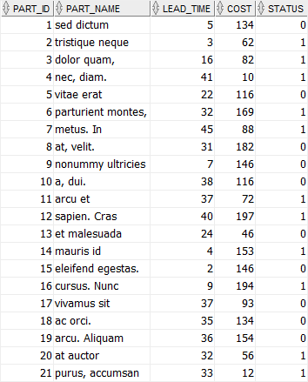

Slide 27
CREATE TABLE parts ( part_id NUMBER GENERATED BY DEFAULT AS IDENTITY, part_name VARCHAR(50) NOT NULL, lead_time NUMBER(2,0) NOT NULL, cost NUMBER(9,2) NOT NULL, status NUMBER(1,0) NOT NULL, PRIMARY KEY (part_id) );

Slide 28
INSERT INTO parts (part_name,lead_time,cost,status) VALUES ('sed dictum',5,134,0);
INSERT INTO parts (part_name,lead_time,cost,status) VALUES ('tristique neque',3,62,1);
INSERT INTO parts (part_name,lead_time,cost,status) VALUES ('dolor quam,',16,82,1);
INSERT INTO parts (part_name,lead_time,cost,status) VALUES ('nec, diam.',41,10,1);
INSERT INTO parts (part_name,lead_time,cost,status) VALUES ('vitae erat',22,116,0);
INSERT INTO parts (part_name,lead_time,cost,status) VALUES ('parturient montes,',32,169,1);
INSERT INTO parts (part_name,lead_time,cost,status) VALUES ('metus. In',45,88,1);
INSERT INTO parts (part_name,lead_time,cost,status) VALUES ('at, velit.',31,182,0);
INSERT INTO parts (part_name,lead_time,cost,status) VALUES ('nonummy ultricies',7,146,0);
INSERT INTO parts (part_name,lead_time,cost,status) VALUES ('a, dui.',38,116,0);
INSERT INTO parts (part_name,lead_time,cost,status) VALUES ('arcu et',37,72,1);
INSERT INTO parts (part_name,lead_time,cost,status) VALUES ('sapien. Cras',40,197,1);
INSERT INTO parts (part_name,lead_time,cost,status) VALUES ('et malesuada',24,46,0);
INSERT INTO parts (part_name,lead_time,cost,status) VALUES ('mauris id',4,153,1);
INSERT INTO parts (part_name,lead_time,cost,status) VALUES ('eleifend egestas.',2,146,0);
INSERT INTO parts (part_name,lead_time,cost,status) VALUES ('cursus. Nunc',9,194,1);
INSERT INTO parts (part_name,lead_time,cost,status) VALUES ('vivamus sit',37,93,0);
INSERT INTO parts (part_name,lead_time,cost,status) VALUES ('ac orci.',35,134,0);
INSERT INTO parts (part_name,lead_time,cost,status) VALUES ('arcu. Aliquam',36,154,0);
INSERT INTO parts (part_name,lead_time,cost,status) VALUES ('at auctor',32,56,1);
INSERT INTO parts (part_name,lead_time,cost,status) VALUES ('purus, accumsan',33,12,1);

Slide 29
SELECT
*
FROM
parts
ORDER BY
part_name;

Slide 30
Oracle UPDATE – update one column of a single row
The following UPDATE statement changes the cost of the part with id 1:
UPDATE
parts
SET
cost = 130
WHERE
part_id = 1;

Slide 31
SELECT
*
FROM
parts
WHERE
part_id = 1;

Slide 32
Oracle UPDATE – update multiple columns of a single row
The following statement updates the lead time, cost, and status of the part whose id is 5.
UPDATE
parts
SET
lead_time = 30,
cost = 120,
status = 1
WHERE
part_id = 5;

Slide 33
Oracle UPDATE – update multiple rows example
The following statement increases the costs of all parts in the parts table 5%:
UPDATE
parts
SET
cost = cost * 1.05;

Slide 34
DELETE
DELETE FROM table_name WHERE condition;

Slide 35
Alter table
ALTER TABLE table_name ADD column_name type constraint;

Slide 36
CREATE TABLE persons(
person_id NUMBER GENERATED BY DEFAULT AS IDENTITY,
first_name VARCHAR2(50) NOT NULL,
last_name VARCHAR2(50) NOT NULL,
PRIMARY KEY(person_id)
);

Slide 37
ALTER TABLE persons ADD birthdate DATE NOT NULL;
If you view the persons table, you will see that the birthdate column is appended at the end of the column list:
DESC persons;

Slide 38
ALTER TABLE table_name
ADD (
column_name type constraint,
column_name type constraint,
...
);

Slide 39
ALTER TABLE persons
ADD (
phone VARCHAR(20),
email VARCHAR(100)
);

Slide 40
Oracle ALTER TABLE MODIFY column
To modify the attributes of a column, you use the following syntax:
ALTER TABLE table_name
MODIFY column_name type constraint;
For example, the following statement changes the birthdate column to a null-able column:
ALTER TABLE persons MODIFY birthdate DATE NULL;

Slide 41
To modify multiple columns, you use the following syntax:
ALTER TABLE table_name
MODIFY ( column_1 type constraint,
column_1 type constraint,
...);
ALTER TABLE persons MODIFY(
phone VARCHAR2(20) NOT NULL,
email VARCHAR2(255) NOT NULL
);

Slide 42
Oracle ALTER TABLE DROP COLUMN example
To remove an existing column from a table, you use the following syntax:
ALTER TABLE table_name
DROP COLUMN column_name;
This statement deletes the column from the table structure and also the data stored in that column.
The following example removes the birthdate column from the persons table:
ALTER TABLE persons
DROP
COLUMN birthdate;

Slide 43
ALTER TABLE table_name
DROP (column_1,column_2,...);
For example, the following statement removes the phone and email columns from the persons table:
ALTER TABLE persons
DROP
( email, phone );

Slide 44
Oracle ALTER TABLE RENAME column example
Since version 9i, Oracle added a clause for rename a column as follows:
ALTER TABLE table_name
RENAME COLUMN column_name TO new_name;
For example, the following statement renames the first_name column to forename column:
ALTER TABLE persons
RENAME COLUMN first_name TO forename;

Slide 45
Oracle ALTER TABLE RENAME table example
To give a table a new name, you use the following syntax:
ALTER TABLE table_name
RENAME TO new_table_name;
For example, the statement below renames the persons table to people table:
ALTER TABLE persons RENAME TO people;

Slide 46
Oracle Drop Column using SET UNUSED COLUMN clause
The process of dropping a column from a big table can be time and resource consuming. Therefore, we typically drop the column logically by using the ALTER TABLE SET UNUSED COLUMN statement as follows:
ALTER TABLE table_name
SET UNUSED COLUMN column_name;
Once you execute the statement, the column is no longer visible for accessing.
During the off-peak hours, you can drop the unused columns physically using the following statement:
ALTER TABLE table_name
DROP UNUSED COLUMNS;

Slide 47
Oracle SET UNUSED COLUMN example
Let’s create a table named suppliers for the demonstration:
CREATE TABLE suppliers (
supplier_id NUMBER GENERATED BY DEFAULT AS IDENTITY,
contact_name VARCHAR2(255) NOT NULL,
company_name VARCHAR2(255),
phone VARCHAR2(100) NOT NULL,
email VARCHAR2(255) NOT NULL,
fax VARCHAR2(100) NOT NULL,
PRIMARY KEY(supplier_id)
);

Slide 48
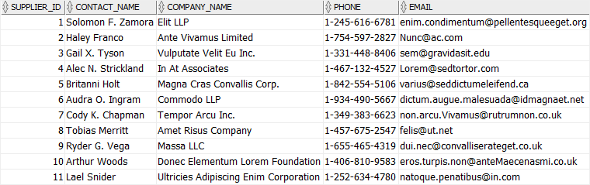

Slide 49
INSERT INTO suppliers (contact_name,company_name,phone,email,fax)
VALUES ('Solomon F. Zamora',
'Elit LLP',
'1-245-616-6781',
'enim.condimentum@pellentesqueeget.org',
'1-593-653-6421');
INSERT INTO suppliers (contact_name,company_name,phone,email,fax)
VALUES ('Haley Franco',
'Ante Vivamus Limited',
'1-754-597-2827',
'Nunc@ac.com',
'1-167-362-9592');
INSERT INTO suppliers (contact_name,company_name,phone,email,fax)
VALUES ('Gail X. Tyson',
'Vulputate Velit Eu Inc.',
'1-331-448-8406',
'sem@gravidasit.edu',
'1-886-556-8494');

Slide 50
INSERT INTO suppliers (contact_name,company_name,phone,email,fax)
VALUES ('Alec N. Strickland',
'In At Associates',
'1-467-132-4527',
'Lorem@sedtortor.com',
'1-735-818-0914');
INSERT INTO suppliers (contact_name,company_name,phone,email,fax)
VALUES ('Britanni Holt',
'Magna Cras Convallis Corp.',
'1-842-554-5106',
'varius@seddictumeleifend.ca',
'1-381-532-1632');
INSERT INTO suppliers (contact_name,company_name,phone,email,fax)
VALUES ('Audra O. Ingram',
'Commodo LLP',
'1-934-490-5667',
'dictum.augue.malesuada@idmagnaet.net',
'1-225-217-4699');

Slide 51
INSERT INTO suppliers (contact_name,company_name,phone,email,fax)
VALUES ('Cody K. Chapman',
'Tempor Arcu Inc.',
'1-349-383-6623',
'non.arcu.Vivamus@rutrumnon.co.uk',
'1-824-229-3521');
INSERT INTO suppliers (contact_name,company_name,phone,email,fax)
VALUES ('Tobias Merritt',
'Amet Risus Company',
'1-457-675-2547',
'felis@ut.net',
'1-404-101-9940');
INSERT INTO suppliers (contact_name,company_name,phone,email,fax)
VALUES ('Ryder G. Vega',
'Massa LLC',
'1-655-465-4319',
'dui.nec@convalliserateget.co.uk',
'1-282-381-9477');

Slide 52
INSERT INTO suppliers (contact_name,company_name,phone,email,fax)
VALUES ('Arthur Woods',
'Donec Elementum Lorem Foundation',
'1-406-810-9583',
'eros.turpis.non@anteMaecenasmi.co.uk',
'1-462-765-8157');
INSERT INTO suppliers (contact_name,company_name,phone,email,fax)
VALUES ('Lael Snider',
'Ultricies Adipiscing Enim Corporation',
'1-252-634-4780',
'natoque.penatibus@in.com',
'1-986-508-6373');

Slide 53
To logically drop the fax column from the suppliers table, you use the following statement:
ALTER TABLE suppliers
SET UNUSED COLUMN fax;
From now on, you cannot access the fax column anymore:
SELECT
*
FROM
suppliers;

Slide 54
You can view the number of unused columns per table from the DBA_UNUSED_COL_TABS view:
SELECT
*
FROM
DBA_UNUSED_COL_TABS;

Slide 55
To drop the all unused columns from the suppliers table, you use the following statement:
ALTER TABLE suppliers
DROP UNUSED COLUMNS;

Slide 56
ALTER TABLE table_name
DROP COLUMN column_name;
ALTER TABLE table_name
DROP (
column_name_1,
column_name_2
);

Slide 57
ALTER TABLE
suppliers
DROP (
email,
phone
);

Slide 58
DROP TABLE persons;

Slide 59
Oracle DROP TABLE CASCADE CONSTRAINTS example
CREATE TABLE brands(
brand_id NUMBER PRIMARY KEY,
brand_name varchar2(50)
);
CREATE TABLE cars(
car_id NUMBER PRIMARY KEY,
make VARCHAR(50) NOT NULL,
model VARCHAR(50) NOT NULL,
year NUMBER NOT NULL,
plate_number VARCHAR(25),
brand_id NUMBER NOT NULL,
CONSTRAINT fk_brand
FOREIGN KEY (brand_id)
REFERENCES brands(brand_id) ON DELETE CASCADE}

Slide 60
The following statement tries to drop the brands table:
DROP TABLE brands;
Oracle issued the following error:
ORA-02449: unique/primary keys in table referenced by foreign keys

Slide 61
To drop the brands table, you must use the CASCADE CONSTRAINTS clause as follows:
DROP TABLE brands CASCADE CONSTRAINTS;
This statement dropped not only the brands table but also the foreign key constraint fk_brand from the cars table.
If you execute again the statement to get the foreign key constraints in the cars table, you will not see any row returned.

Slide 62
When you want to delete all data from a table, you use the DELETE statement without theWHERE clause as follows:
DELETE FROM table_name;
For a table with a small number of rows, the DELETE statement does a good job. However, when you have a table with a large number of rows, using the DELETE statement to remove all data is not efficient.
Oracle introduced the TRUNCATE TABLE statement that allows you to delete all rows from a big table.
The following illustrates the syntax of the Oracle TRUNCATE TABLE statement:
TRUNCATE TABLE schema_name.table_name
[CASCADE]
[[ PRESERVE | PURGE] MATERIALIZED VIEW LOG ]]
[[ DROP | REUSE]] STORAGE ]
By default, to remove all rows from a table, you specify the name of the table that you want to truncate in the TRUNCATE TABLE clause:
TRUNCATE TABLE table_name;
In this case, because we don’t specify the schema name explicitly, Oracle assumes that we truncate the table from our own schema.
If a table has relationships with other tables via the foreign key constraints, you need to use the CASCADE clause:
TRUNCATE TABLE table_name
CASCADE;
In this case, the TRUNCATE TABLE CASCADE statement deletes all rows from the table_name, and recursively truncates down the associated tables in the chain.

Slide 63
CREATE TABLE quotations (
quotation_no NUMERIC GENERATED BY DEFAULT AS IDENTITY,
customer_id NUMERIC NOT NULL,
valid_from DATE NOT NULL,
valid_to DATE NOT NULL,
PRIMARY KEY(quotation_no)
);
CREATE TABLE quotation_items (
quotation_no NUMERIC,
item_no NUMERIC ,
product_id NUMERIC NOT NULL,
qty NUMERIC NOT NULL,
price NUMERIC(9 , 2 ) NOT NULL,
PRIMARY KEY (quotation_no , item_no),
CONSTRAINT fk_quotation FOREIGN KEY (quotation_no)
REFERENCES quotations
ON DELETE CASCADE
);

Slide 64
INSERT INTO quotations(customer_id, valid_from, valid_to)
VALUES(100, DATE '2017-09-01', DATE '2017-12-01');
INSERT INTO quotation_items(quotation_no, item_no, product_id, qty, price)
VALUES(1,1,1001,10,90.5);
INSERT INTO quotation_items(quotation_no, item_no, product_id, qty, price)
VALUES(1,2,1002,20,200.5);
INSERT INTO quotation_items(quotation_no, item_no, product_id, qty, price)
VALUES(1,3,1003,30, 150.5);

Slide 65
TRUNCATE TABLE quotations CASCADE;

Slide 66
CREATE TABLE promotions(
promotion_id NUMBER GENERATED BY DEFAULT AS IDENTITY,
promotion_name varchar2(255),
start_date DATE NOT NULL,
end_date DATE NOT NULL,
PRIMARY KEY(promotion_id),
CHECK (end_date > start_date)
);
RENAME promotions TO campaigns;

Slide 67
Aliases
SELECT
first_name AS forename,
last_name AS surname
FROM
employees;
SELECT
first_name || ' ' || last_name AS "Full Name"
FROM
employees;

Slide 68
SELECT
product_name,
list_price - standard_cost AS gross_profit
FROM
products;

Slide 69
Oracle table alias
Similar to a column name, you can assign a table name an alias. A table alias is a temporary name for a table in a query. You specify a table alias after the table name either with or without the AS keyword:
table_name AS table_alias
table_name table_alias
Without the table alias, you qualify a column by using the following form:
table_name.column_name
However, you must use an alias instead of the table name after you assign the table a table alias:
table_alias.column_name

Slide 70
SELECT
e.first_name employee,
m.first_name manager
FROM
employees e
INNER JOIN employees m
ON
m.employee_id = e.employee_id;

Slide 71
Create orders table
order_id, customer_id , salesman_id NUMBER( 6, 0 ) order_date

Slide 72
CREATE TABLE orders
(
order_id NUMBER
GENERATED BY DEFAULT AS IDENTITY START WITH 106
PRIMARY KEY,
customer_id NUMBER( 6, 0 ) NOT NULL, -- fk
status VARCHAR( 20 ) NOT NULL ,
salesman_id NUMBER( 6, 0 ) , -- fk
order_date DATE NOT NULL ,
CONSTRAINT fk_orders_customers
FOREIGN KEY( customer_id )
REFERENCES customers( customer_id )
ON DELETE CASCADE,
CONSTRAINT fk_orders_employees
FOREIGN KEY( salesman_id )
REFERENCES employees( employee_id )
ON DELETE SET NULL
);

Slide 73
Insert into ORDERS (ORDER_ID,CUSTOMER_ID,STATUS,SALESMAN_ID,ORDER_DATE) values
(100,200,‘Shipped',1,to_date('17-NOV-16','DD-MON-RR'));
Insert into ORDERS (ORDER_ID,CUSTOMER_ID,STATUS,SALESMAN_ID,ORDER_DATE) values
(101,201,'Pending',2,to_date('20-FEB-17','DD-MON-RR'));
Insert into ORDERS (ORDER_ID,CUSTOMER_ID,STATUS,SALESMAN_ID,ORDER_DATE) values
(101,3,'Pending',55,to_date('03-JAN-17','DD-MON-RR'));
Insert into ORDERS (ORDER_ID,CUSTOMER_ID,STATUS,SALESMAN_ID,ORDER_DATE) values
(1,4,'Pending',56,to_date('15-OCT-17','DD-MON-RR'));
Insert into ORDERS (ORDER_ID,CUSTOMER_ID,STATUS,SALESMAN_ID,ORDER_DATE) values
(5,5,'Canceled',56,to_date('09-APR-17','DD-MON-RR'));
Insert into ORDERS (ORDER_ID,CUSTOMER_ID,STATUS,SALESMAN_ID,ORDER_DATE) values
(28,6,'Canceled',57,to_date('15-AUG-17','DD-MON-RR'));
Insert into ORDERS (ORDER_ID,CUSTOMER_ID,STATUS,SALESMAN_ID,ORDER_DATE) values
(87,7,'Canceled',57,to_date('01-DEC-16','DD-MON-RR'));
Insert into ORDERS (ORDER_ID,CUSTOMER_ID,STATUS,SALESMAN_ID,ORDER_DATE) values
(4,8,'Shipped',59,to_date('09-APR-15','DD-MON-RR'));
Insert into ORDERS (ORDER_ID,CUSTOMER_ID,STATUS,SALESMAN_ID,ORDER_DATE) values
(41,9,'Shipped',59,to_date('11-MAY-17','DD-MON-RR'));

Slide 74
SELECT
order_id,
customer_id,
status,
order_date
FROM
orders
WHERE
status = 'Pending'
AND customer_id = 2
ORDER BY
order_date;

Slide 75
SQL statement that retrieves the orders that meet all the following conditions:
placed in 2009
is in charge of the salesman id 1
has the shipped status.

Slide 76
SELECT
order_id,
customer_id,
status,
order_date
FROM
orders
WHERE
status = 'Shipped'
AND salesman_id = 60
AND EXTRACT(YEAR FROM order_date) = 2017
ORDER BY
order_date;

Slide 77
SELECT
order_id,
customer_id,
status,
order_date
FROM
orders
WHERE
status = 'Pending'
OR status = 'Canceled'
ORDER BY
order_date DESC;

Slide 78
LIMIT
FETCH clause to limit the rows returned by a query.
SELECT
product_name,(products table)
quantity(inventories table)
FROM
inventories
INNER JOIN products
USING(product_id)
ORDER BY
quantity DESC
LIMIT 5;
The ORDER BY clause sorts the products by stock quantity in descending order and the LIMIT clause returns only the first 5 products with the highest stock quantity

Slide 79
Top N rows example
SELECT
product_name,
quantity
FROM
inventories
INNER JOIN products
USING(product_id)
ORDER BY
quantity DESC
FETCH NEXT 10 ROWS ONLY; The statement returns the top 10 products with the highest inventory level:

Slide 80
With Ties
SELECT
product_name,
quantity
FROM
inventories
INNER JOIN products
USING(product_id)
ORDER BY
quantity DESC
FETCH NEXT 10 ROWS WITH TIES; Even though the query requested 10 rows, because it had the WITH TIES option, the query returned two more additional rows. Notice that these two additional rows have the same value in the quantity column as the row 10.

Slide 81
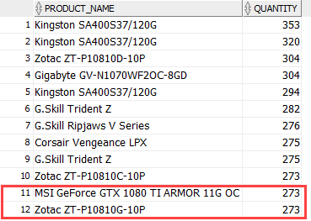

Slide 82
SELECT
product_name,
quantity
FROM
inventories
INNER JOIN products
USING(product_id)
ORDER BY
quantity DESC
FETCH FIRST 5 PERCENT ROWS ONLY;
The inventories table has 1112 rows, therefore, 5% of 1112 is 55.6 which is rounded up to 56 (rows).

Slide 83
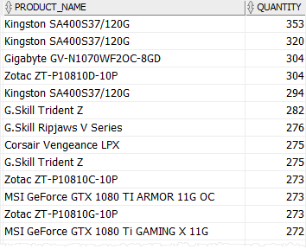

Slide 84
Offset
The OFFSET clause specifies the number of rows to skip before the row limiting starts
SELECT
product_name,
quantity
FROM
inventories
INNER JOIN products
USING(product_id)
ORDER BY
quantity DESC
OFFSET 10 ROWS
FETCH NEXT 10 ROWS ONLY; The query skips the first 10 products with the highest level of inventory and returns the next 10 ones:

Slide 85
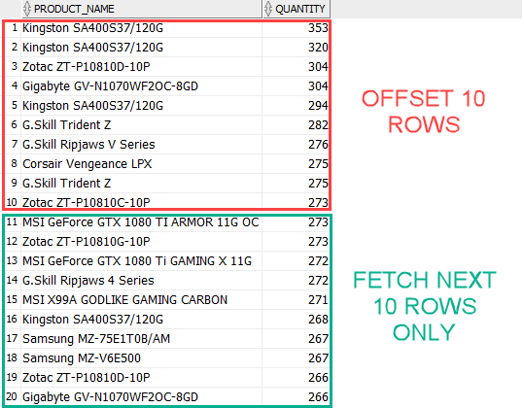

Slide 86
SELECT
*
FROM
orders
INNER JOIN order_items ON
order_items.order_id = orders.order_id
ORDER BY
order_date DESC;

Slide 87
Insert into ORDER_ITEMS (ORDER_ID,ITEM_ID,PRODUCT_ID,QUANTITY,UNIT_PRICE) values
(100,3,247,149,339.99);
Insert into ORDER_ITEMS (ORDER_ID,ITEM_ID,PRODUCT_ID,QUANTITY,UNIT_PRICE) values
(101,7,178,145,1999.89);
Insert into PRODUCTS
(PRODUCT_ID,PRODUCT_NAME,DESCRIPTION,STANDARD_COST,LIST_PRICE,CATEGORY_ID) values
(247,'MSI Z170A KRAIT GAMING 3X','CPU:LGA1151,Form Factor:ATX,RAM Slots:4,Max
RAM:64GB',245.4,299.89,4);
Insert into PRODUCTS
(PRODUCT_ID,PRODUCT_NAME,DESCRIPTION,STANDARD_COST,LIST_PRICE,CATEGORY_ID) values
(178,'MSI Z170 Krait Gaming','CPU:LGA1151,Form Factor:ATX,RAM Slots:4,Max
RAM:64GB',231.58,299.89,5);
Insert into PRODUCT_CATEGORIES (CATEGORY_ID,CATEGORY_NAME) values (4,'CPU');
Insert into PRODUCT_CATEGORIES (CATEGORY_ID,CATEGORY_NAME) values (5,'Video Card');

Slide 88
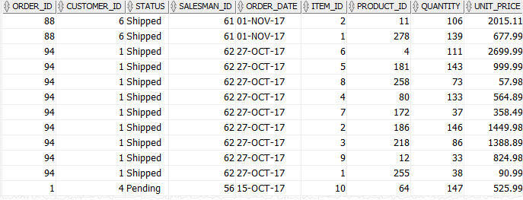

Slide 89
Joining multiple tables
SELECT
name AS customer_name,
order_id,
order_date,
item_id,
product_name,
quantity,
unit_price
FROM
orders
INNER JOIN order_items
USING(order_id)
INNER JOIN customers
USING(customer_id)
INNER JOIN products
USING(product_id)
ORDER BY
order_date DESC,
order_id DESC,
item_id ASC;

Slide 90
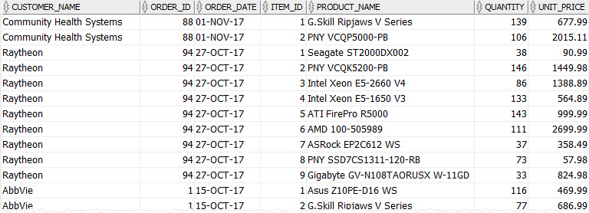

Slide 91
Left Join
SELECT
order_id,
status,
first_name,
last_name
FROM
orders
LEFT JOIN employees ON employee_id = salesman_id
ORDER BY
order_date DESC;

Slide 92
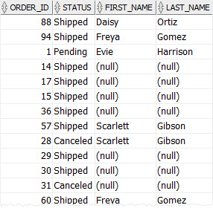

Slide 93
Left join multiple table
SELECT
order_id,
name AS customer_name,
status,
first_name,
last_name
FROM
orders
LEFT JOIN employees ON
employee_id = salesman_id
LEFT JOIN customers ON
customers.customer_id = orders.customer_id
ORDER BY
order_date DESC;

Slide 94
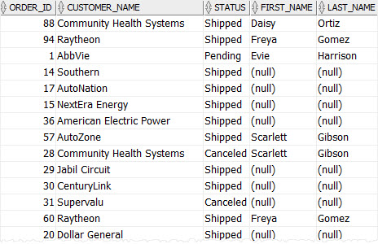

Slide 95
Right Join
SELECT
first_name,
last_name,
order_id,
status
FROM
orders
RIGHT JOIN employees ON
employee_id = salesman_id
WHERE
job_title = 'Sales Representative'
ORDER BY
first_name,
last_name;

Slide 96
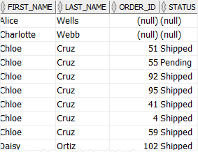

Slide 97
ROLLUP
SELECT
customer_id,
SUM(quantity * unit_price) amount
FROM
orders
INNER JOIN order_items USING (order_id)
WHERE
status = 'Shipped' AND
salesman_id IS NOT NULL AND
EXTRACT(YEAR FROM order_date) = 2017
GROUP BY
ROLLUP(customer_id);

Slide 98
SELECT
col1,
col2,
aggregate(col3)
FROM
table_name
GROUP BY
ROLLUP (col1, col2);

Slide 99
The ROLLUP works as follows:
First, calculate the standard aggregate values in the GROUP BY clause.
Then, progressively create higher-level subtotals of the grouping columns, which are col2 and col1 columns, from right to left.
Finally, calculate the grand total.

Slide 100
SELECT
salesman_id,
customer_id,
SUM(quantity * unit_price) amount
FROM
orders
INNER JOIN order_items USING (order_id)
WHERE
status = 'Shipped' AND
salesman_id IS NOT NULL AND
EXTRACT(YEAR FROM order_date) = 2017
GROUP BY
ROLLUP(salesman_id,customer_id);

Slide 101
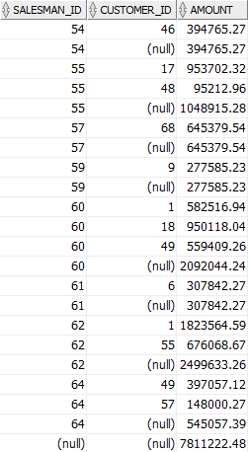

Slide 102
As you can see from the output, the query returned the following set of rows:
The regular aggregation rows that would be returned by the GROUP BY clause without using the ROLLUP expression.
The first-level of subtotals aggregating across salesman for each combination of salesman and customer.
The second-level subtotals aggregating across salesman and customer for each salesman.
A grand total row.

Slide 103
SELECT
salesman_id,
customer_id,
SUM(quantity * unit_price) amount
FROM
orders
INNER JOIN order_items USING (order_id)
WHERE
status = 'Shipped' AND
salesman_id IS NOT NULL AND
EXTRACT(YEAR FROM order_date) = 2017
GROUP BY
salesman_id,
ROLLUP(customer_id);

Slide 104
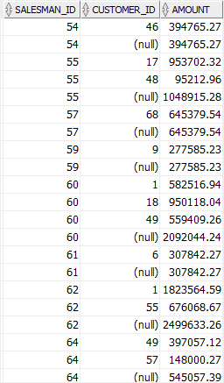

Slide 105
The CUBE is an extension of the GROUP BY clause that allows you to generate grouping sets for all possible combinations of dimension

Slide 106
SELECT
category,
customer,
SUM(sales_amount)
FROM
customer_category_sales
GROUP BY
CUBE(category,customer)
ORDER BY
category NULLS LAST,
customer NULLS LAST;

Slide 107
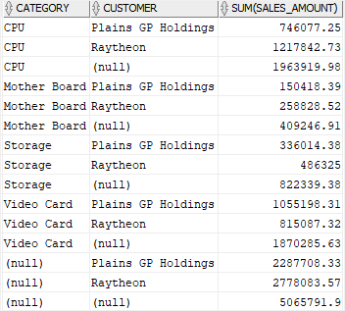

Slide 108
The statement returns 4 subtotals:
A subtotal by category.
A subtotal by customer.
A subtotal by both category and customer.
A grand total.

Slide 109
GROUP BY
The GROUP BY clause is used in a SELECT statement to group rows into a set of summary rows by values of columns or expressions. The GROUP BY clause returns one row per group.SELECT
customer_id,
COUNT( order_id )
FROM
orders
GROUP BY
customer_id
ORDER BY
customer_id;

Slide 110
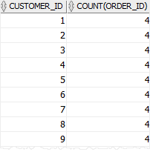

Slide 111
IN
The Oracle IN operator determines whether a value matches any values in a list or a subquery.
The following statement finds all orders which are in charge of the salesman id 54, 55, and 56:

Slide 112
SELECT
order_id,
customer_id,
status,
salesman_id
FROM
orders
WHERE
salesman_id IN (
54,
55,
56
)
ORDER BY
order_id;

Slide 113
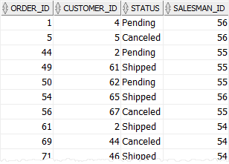

Slide 114
Retrieves sales orders whose statuses are Pending or Canceled:
SELECT
order_id,
customer_id,
status,
salesman_id
FROM
orders
WHERE
status IN(
'Pending',
'Canceled'
)
ORDER BY
order_id;

Slide 115
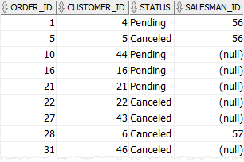

Slide 116
NOT IN
SELECT
order_id,
customer_id,
status,
salesman_id
FROM
orders
WHERE
status NOT IN(
'Shipped',
'Canceled'
)
ORDER BY
order_id;

Slide 117
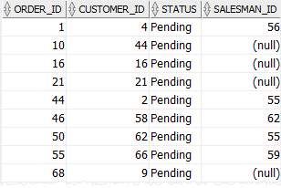

Slide 118
IN SUBQUERY
Returns the id, first name, and last name of salesmen who are in charge of orders that were canceled

Slide 119
SELECT
employee_id,
first_name,
last_name
FROM
employees
WHERE
employee_id IN(
SELECT
DISTINCT salesman_id
FROM
orders
WHERE
status = 'Canceled'
);
ORDER BY
first_Name;

Slide 120
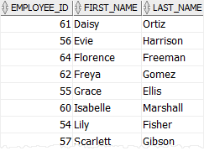

Slide 121
Find customers who have not placed any orders

Slide 122
SELECT
customer_id,
name
FROM
customers
WHERE
customer_id NOT IN(
SELECT
customer_id
FROM
orders
);

Slide 123
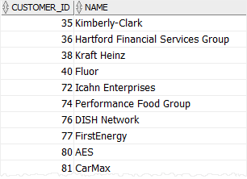

Slide 124
HAVING
The HAVING clause is an optional clause of the SELECT statement. It is used to filter groups of rows returned by the GROUP BY clause. This is why the HAVING clause is usually used with the GROUP BY clause.

Slide 125
GROUP BY clause to retrieve the orders and their values from the order_items table:
SELECT
order_id,
SUM( unit_price * quantity ) order_value
FROM
order_items
GROUP BY
order_id
ORDER BY
order_value DESC;

Slide 126
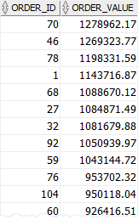

Slide 127
SELECT
order_id,
SUM( unit_price * quantity ) order_value
FROM
order_items
GROUP BY
order_id
HAVING
SUM( unit_price * quantity ) > 1000000
ORDER BY
order_value DESC;

Slide 128
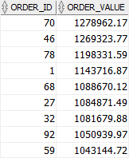

Slide 129
First, the GROUP BY clause groups orders by their ids and calculates the order values using the SUM() function.
Then, the HAVING clause filters all orders whose values are less than or equal to 1,000,000

Slide 130
SELECT
order_id,
COUNT( item_id ) item_count,
SUM( unit_price * quantity ) total
FROM
order_items
GROUP BY
order_id
HAVING
SUM( unit_price * quantity ) > 500000 AND
COUNT( item_id ) BETWEEN 10 AND 12
ORDER BY
total DESC,
item_count DESC;

Slide 131
ANY
ANY operator is used to compare a value to a list of values or result set returned by a subquery.

Slide 132
SELECT
*
FROM
table_name
WHERE
c > ANY (
v1,
v2,
v3
);

Slide 133
SELECT
product_name,
list_price
FROM
products
WHERE
list_price > ANY(
SELECT
list_price
FROM
products
WHERE
category_id = 1
)
ORDER BY
product_name;

Slide 134
Col=ANY(list)
SELECT
product_name,
list_price
FROM
products
WHERE
list_price = ANY(
2200,
2259.99,
2269.99
)
AND category_id = 1;

Slide 135
col != ANY(list)
SELECT
product_name,
list_price
FROM
products
WHERE
list_price != ANY(
2200,
2259.99,
2269.99
)
AND category_id = 1
ORDER BY
list_price DESC;

Slide 136
SELECT
product_name,
list_price
FROM
products
WHERE
list_price > ANY(
2200,
2259.99,
2269.99
)
AND category_id = 1
ORDER BY
list_price DESC;

Slide 137
EXISTS
EXISTS operator is often used with a subquery to test for the existence of rows:

Slide 138
SELECT
*
FROM
table_name
WHERE
EXISTS(subquery);

Slide 139
SELECT
name
FROM
customers c
WHERE
EXISTS (
SELECT
1
FROM
orders
WHERE
customer_id = c.customer_id
)
ORDER BY
name;

Slide 140
ALL
ALL operator is used to compare a value to a list of values or result set returned by a subquery.

Slide 141
SELECT
product_name,
list_price
FROM
products
WHERE
list_price > ALL(
SELECT
AVG( list_price )
FROM
products
GROUP BY
category_id
)
ORDER BY
list_price ASC;

Slide 142
Products table
CREATE TABLE products
(
product_id NUMBER
GENERATED BY DEFAULT AS IDENTITY START WITH 289
PRIMARY KEY,
product_name VARCHAR2( 255 ) NOT NULL,
description VARCHAR2( 2000 ) ,
standard_cost NUMBER( 9, 2 ) ,
list_price NUMBER( 9, 2 ) ,
category_id NUMBER NOT NULL ,
CONSTRAINT fk_products_categories
FOREIGN KEY( category_id )
REFERENCES product_categories( category_id )
ON DELETE CASCADE
);

Slide 143
Insert into OT.PRODUCTS (PRODUCT_ID,PRODUCT_NAME,DESCRIPTION,STANDARD_COST,LIST_PRICE,CATEGORY_ID) values (228,'Intel Xeon E5-2699 V3 (OEM/Tray)','Speed:2.3GHz,Cores:18,TDP:145W',2867.51,3410.46,1);
Insert into OT.PRODUCTS (PRODUCT_ID,PRODUCT_NAME,DESCRIPTION,STANDARD_COST,LIST_PRICE,CATEGORY_ID) values (248,'Intel Xeon E5-2697 V3','Speed:2.6GHz,Cores:14,TDP:145W',2326.27,2774.98,1);
Insert into OT.PRODUCTS (PRODUCT_ID,PRODUCT_NAME,DESCRIPTION,STANDARD_COST,LIST_PRICE,CATEGORY_ID) values (249,'Intel Xeon E5-2698 V3 (OEM/Tray)','Speed:2.3GHz,Cores:16,TDP:135W',2035.18,2660.72,1);
Insert into OT.PRODUCTS (PRODUCT_ID,PRODUCT_NAME,DESCRIPTION,STANDARD_COST,LIST_PRICE,CATEGORY_ID) values (2,'Intel Xeon E5-2697 V4','Speed:2.3GHz,Cores:18,TDP:145W',2144.4,2554.99,1);
Insert into OT.PRODUCTS (PRODUCT_ID,PRODUCT_NAME,DESCRIPTION,STANDARD_COST,LIST_PRICE,CATEGORY_ID) values (45,'Intel Xeon E5-2685 V3 (OEM/Tray)','Speed:2.6GHz,Cores:12,TDP:120W',2012.11,2501.69,1);
Insert into OT.PRODUCTS (PRODUCT_ID,PRODUCT_NAME,DESCRIPTION,STANDARD_COST,LIST_PRICE,CATEGORY_ID) values (46,'Intel Xeon E5-2695 V3 (OEM/Tray)','Speed:2.3GHz,Cores:14,TDP:120W',1925.13,2431.95,1);
Insert into OT.PRODUCTS (PRODUCT_ID,PRODUCT_NAME,DESCRIPTION,STANDARD_COST,LIST_PRICE,CATEGORY_ID) values (47,'Intel Xeon E5-2697 V2','Speed:2.7GHz,Cores:12,TDP:130W',2101.59,2377.09,1);
Insert into OT.PRODUCTS (PRODUCT_ID,PRODUCT_NAME,DESCRIPTION,STANDARD_COST,LIST_PRICE,CATEGORY_ID) values (51,'Intel Xeon E5-2695 V4','Speed:2.1GHz,Cores:18,TDP:120W',1780.35,2269.99,1);
Insert into OT.PRODUCTS (PRODUCT_ID,PRODUCT_NAME,DESCRIPTION,STANDARD_COST,LIST_PRICE,CATEGORY_ID) values (91,'Intel Xeon E5-2695 V2','Speed:2.4GHz,Cores:12,TDP:115W',1793.53,2259.99,1);
Insert into OT.PRODUCTS (PRODUCT_ID,PRODUCT_NAME,DESCRIPTION,STANDARD_COST,LIST_PRICE,CATEGORY_ID) values (92,'Intel Xeon E5-2643 V2 (OEM/Tray)','Speed:3.5GHz,Cores:6,TDP:130W',1940.18,2200,1);
Insert into OT.PRODUCTS (PRODUCT_ID,PRODUCT_NAME,DESCRIPTION,STANDARD_COST,LIST_PRICE,CATEGORY_ID) values (93,'Intel Xeon E5-2690 (OEM/Tray)','Speed:2.9GHz,Cores:8,TDP:135W',1888.33,2116.72,1);
Insert into OT.PRODUCTS (PRODUCT_ID,PRODUCT_NAME,DESCRIPTION,STANDARD_COST,LIST_PRICE,CATEGORY_ID) values (98,'Intel Xeon E5-2687W V3','Speed:3.1GHz,Cores:10,TDP:160W',1781.47,2064.99,1);
Insert into OT.PRODUCTS (PRODUCT_ID,PRODUCT_NAME,DESCRIPTION,STANDARD_COST,LIST_PRICE,CATEGORY_ID) values (102,'Intel Xeon E5-2687W V4','Speed:3.0GHz,Cores:12,TDP:160W',1723.83,2042.69,1);
Insert into OT.PRODUCTS (PRODUCT_ID,PRODUCT_NAME,DESCRIPTION,STANDARD_COST,LIST_PRICE,CATEGORY_ID) values (158,'Intel Xeon E5-2667 V3 (OEM/Tray)','Speed:3.2GHz,Cores:8,TDP:135W',1504.08,2009.46,1);
Insert into OT.PRODUCTS (PRODUCT_ID,PRODUCT_NAME,DESCRIPTION,STANDARD_COST,LIST_PRICE,CATEGORY_ID) values (159,'Intel Xeon E5-2690 V4','Speed:2.6GHz,Cores:14,TDP:135W',1499.26,1994.49,1);
Insert into OT.PRODUCTS (PRODUCT_ID,PRODUCT_NAME,DESCRIPTION,STANDARD_COST,LIST_PRICE,CATEGORY_ID) values (160,'Intel Xeon E5-2690 V3','Speed:2.6GHz,Cores:12,TDP:135W',1540.35,1908.73,1);
Insert into OT.PRODUCTS (PRODUCT_ID,PRODUCT_NAME,DESCRIPTION,STANDARD_COST,LIST_PRICE,CATEGORY_ID) values (162,'Intel Xeon E5-2470V2','Speed:2.4GHz,Cores:10,TDP:95W',1671.95,1904.7,1);
Insert into OT.PRODUCTS (PRODUCT_ID,PRODUCT_NAME,DESCRIPTION,STANDARD_COST,LIST_PRICE,CATEGORY_ID) values (163,'Intel Xeon E5-2683 V4','Speed:2.1GHz,Cores:16,TDP:120W',1706.95,1899.99,1);
Insert into OT.PRODUCTS (PRODUCT_ID,PRODUCT_NAME,DESCRIPTION,STANDARD_COST,LIST_PRICE,CATEGORY_ID) values (164,'Intel Xeon E5-2637 V2 (OEM/Tray)','Speed:3.5GHz,Cores:4,TDP:130W',1323.12,1850,1);
Insert into OT.PRODUCTS (PRODUCT_ID,PRODUCT_NAME,DESCRIPTION,STANDARD_COST,LIST_PRICE,CATEGORY_ID) values (169,'Intel Xeon E5-2683 V4 (OEM/Tray)','Speed:2.1GHz,Cores:16,TDP:120W',1369.83,1844.89,1);
Insert into OT.PRODUCTS (PRODUCT_ID,PRODUCT_NAME,DESCRIPTION,STANDARD_COST,LIST_PRICE,CATEGORY_ID) values (240,'Intel Core i7-4960X Extreme Edition','Speed:3.6GHz,Cores:6,TDP:130W',1496.43,1805.97,1);
Insert into OT.PRODUCTS (PRODUCT_ID,PRODUCT_NAME,DESCRIPTION,STANDARD_COST,LIST_PRICE,CATEGORY_ID) values (241,'Intel Xeon E5-2699 V4 (OEM/Tray)','Speed:2.2GHz,Cores:22,TDP:145W',1535.62,1756,1);

Slide 144
Insert into OT.PRODUCTS (PRODUCT_ID,PRODUCT_NAME,DESCRIPTION,STANDARD_COST,LIST_PRICE,CATEGORY_ID) values (242,'Intel Xeon E5-1680 V3 (OEM/Tray)','Speed:3.2GHz,Cores:8,TDP:140W',1519.85,1751.99,1);
Insert into OT.PRODUCTS (PRODUCT_ID,PRODUCT_NAME,DESCRIPTION,STANDARD_COST,LIST_PRICE,CATEGORY_ID) values (243,'Intel Xeon E5-2643 V4 (OEM/Tray)','Speed:3.4GHz,Cores:6,TDP:135W',1225.59,1708.86,1);
Insert into OT.PRODUCTS (PRODUCT_ID,PRODUCT_NAME,DESCRIPTION,STANDARD_COST,LIST_PRICE,CATEGORY_ID) values (19,'Intel Core i7-6950X (OEM/Tray)','Speed:3.0GHz,Cores:10,TDP:140W',1479.56,1704.37,1);
Insert into OT.PRODUCTS (PRODUCT_ID,PRODUCT_NAME,DESCRIPTION,STANDARD_COST,LIST_PRICE,CATEGORY_ID) values (52,'Intel Xeon E5-2670 V3','Speed:2.3GHz,Cores:12,TDP:120W',1453.94,1676.98,1);
Insert into OT.PRODUCTS (PRODUCT_ID,PRODUCT_NAME,DESCRIPTION,STANDARD_COST,LIST_PRICE,CATEGORY_ID) values (165,'Intel Xeon E5-2680','Speed:2.7GHz,Cores:8,TDP:130W',1479.95,1666.61,1);
Insert into OT.PRODUCTS (PRODUCT_ID,PRODUCT_NAME,DESCRIPTION,STANDARD_COST,LIST_PRICE,CATEGORY_ID) values (212,'Intel Xeon E5-2680 V4','Speed:2.4GHz,Cores:14,TDP:120W',1365.13,1639.99,1);
Insert into OT.PRODUCTS (PRODUCT_ID,PRODUCT_NAME,DESCRIPTION,STANDARD_COST,LIST_PRICE,CATEGORY_ID) values (166,'Intel Xeon E5-2680 V3 (OEM/Tray)','Speed:2.5GHz,Cores:12,TDP:120W',1166.89,1638.89,1);
Insert into OT.PRODUCTS (PRODUCT_ID,PRODUCT_NAME,DESCRIPTION,STANDARD_COST,LIST_PRICE,CATEGORY_ID) values (82,'Intel Core i7-6950X','Speed:3.0GHz,Cores:10,TDP:140W',1052.92,1499.89,1);
Insert into OT.PRODUCTS (PRODUCT_ID,PRODUCT_NAME,DESCRIPTION,STANDARD_COST,LIST_PRICE,CATEGORY_ID) values (213,'Intel Xeon E5-2643 V3 (OEM/Tray)','Speed:3.4GHz,Cores:6,TDP:135W',1266.37,1469.96,1);
Insert into OT.PRODUCTS (PRODUCT_ID,PRODUCT_NAME,DESCRIPTION,STANDARD_COST,LIST_PRICE,CATEGORY_ID) values (218,'Intel Xeon E5-2660 V4','Speed:2.0GHz,Cores:14,TDP:105W',1194.03,1388.89,1);
Insert into OT.PRODUCTS (PRODUCT_ID,PRODUCT_NAME,DESCRIPTION,STANDARD_COST,LIST_PRICE,CATEGORY_ID) values (219,'Intel Xeon E5-2660 V3','Speed:2.6GHz,Cores:10,TDP:105W',1041.99,1299.73,1);
Insert into OT.PRODUCTS (PRODUCT_ID,PRODUCT_NAME,DESCRIPTION,STANDARD_COST,LIST_PRICE,CATEGORY_ID) values (85,'Intel Xeon E5-2660 V3 (OEM/Tray)','Speed:2.6GHz,Cores:10,TDP:105W',902.18,1274.99,1);
Insert into OT.PRODUCTS (PRODUCT_ID,PRODUCT_NAME,DESCRIPTION,STANDARD_COST,LIST_PRICE,CATEGORY_ID) values (153,'Intel Xeon E5-2650 V2','Speed:2.6GHz,Cores:8,TDP:95W',961.11,1249,1);
Insert into OT.PRODUCTS (PRODUCT_ID,PRODUCT_NAME,DESCRIPTION,STANDARD_COST,LIST_PRICE,CATEGORY_ID) values (154,'Intel Xeon E5-2650 V3','Speed:2.3GHz,Cores:10,TDP:105W',906.63,1204.98,1);
Insert into OT.PRODUCTS (PRODUCT_ID,PRODUCT_NAME,DESCRIPTION,STANDARD_COST,LIST_PRICE,CATEGORY_ID) values (209,'Intel Core i7-990X Extreme Edition','Speed:3.47GHz,Cores:6,TDP:130W',1072.79,1199.99,1);
Insert into OT.PRODUCTS (PRODUCT_ID,PRODUCT_NAME,DESCRIPTION,STANDARD_COST,LIST_PRICE,CATEGORY_ID) values (81,'Intel Xeon E5-2650 V4','Speed:2.2GHz,Cores:12,TDP:105W',945.11,1099.99,1);
Insert into OT.PRODUCTS (PRODUCT_ID,PRODUCT_NAME,DESCRIPTION,STANDARD_COST,LIST_PRICE,CATEGORY_ID) values (211,'Intel Xeon E5-2650','Speed:2.0GHz,Cores:8,TDP:95W',869.03,1064.99,1);
Insert into OT.PRODUCTS (PRODUCT_ID,PRODUCT_NAME,DESCRIPTION,STANDARD_COST,LIST_PRICE,CATEGORY_ID) values (210,'Intel Core i9-7900X','Speed:3.3GHz,Cores:10,TDP:140W',855.82,1029.99,1);
Insert into OT.PRODUCTS (PRODUCT_ID,PRODUCT_NAME,DESCRIPTION,STANDARD_COST,LIST_PRICE,CATEGORY_ID) values (54,'Intel Xeon E5-1660 V3 (OEM/Tray)','Speed:3.0GHz,Cores:8,TDP:140W',914.52,1019.99,1);
Insert into OT.PRODUCTS (PRODUCT_ID,PRODUCT_NAME,DESCRIPTION,STANDARD_COST,LIST_PRICE,CATEGORY_ID) values (167,'Intel Xeon E5-2650L V3 (OEM/Tray)','Speed:1.8GHz,Cores:12,TDP:65W',779.17,1010.46,1);
Insert into OT.PRODUCTS (PRODUCT_ID,PRODUCT_NAME,DESCRIPTION,STANDARD_COST,LIST_PRICE,CATEGORY_ID) values (214,'Intel Core i7-5960X','Speed:3.0GHz,Cores:8,TDP:140W',865.59,1009.79,1);
Insert into OT.PRODUCTS (PRODUCT_ID,PRODUCT_NAME,DESCRIPTION,STANDARD_COST,LIST_PRICE,CATEGORY_ID) values (53,'Intel Core 2 Extreme QX6800','Speed:2.93GHz,Cores:4,TDP:100W',787.72,1003.98,1);

Slide 145
Query to get the most expensive product information??

Slide 146
SUBQUERY
SELECT
product_id,
product_name,
list_price
FROM
products
WHERE
list_price = (
SELECT
MAX( list_price )
FROM
products
);

Slide 147
CREATE TABLE employees
(
employee_id NUMBER
GENERATED BY DEFAULT AS IDENTITY START WITH 108
PRIMARY KEY,
first_name VARCHAR( 255 ) NOT NULL,
last_name VARCHAR( 255 ) NOT NULL,
email VARCHAR( 255 ) NOT NULL,
phone VARCHAR( 50 ) NOT NULL ,
hire_date DATE NOT NULL ,
job_title VARCHAR( 255 ) NOT NULL
);

Slide 148
CREATE TABLE orders
(
order_id NUMBER
GENERATED BY DEFAULT AS IDENTITY START WITH 106
PRIMARY KEY,
customer_id NUMBER( 6, 0 ) NOT NULL, -- fk
status VARCHAR( 20 ) NOT NULL ,
salesman_id NUMBER( 6, 0 ) , -- fk
order_date DATE NOT NULL ,
CONSTRAINT fk_orders_customers
FOREIGN KEY( customer_id )
REFERENCES customers( customer_id )
ON DELETE CASCADE,
CONSTRAINT fk_orders_employees
FOREIGN KEY( salesman_id )
REFERENCES employees( employee_id )
ON DELETE SET NULL
);

Slide 149
CREATE TABLE order_items
(
order_id NUMBER( 12, 0 ) , -- fk
item_id NUMBER( 12, 0 ) ,
product_id NUMBER( 12, 0 ) NOT NULL , -- fk
quantity NUMBER( 8, 2 ) NOT NULL ,
unit_price NUMBER( 8, 2 ) NOT NULL ,
CONSTRAINT pk_order_items
PRIMARY KEY( order_id, item_id ),
CONSTRAINT fk_order_items_products
FOREIGN KEY( product_id )
REFERENCES products( product_id )
ON DELETE CASCADE,
CONSTRAINT fk_order_items_orders
FOREIGN KEY( order_id )
REFERENCES orders( order_id )
ON DELETE CASCADE
);

Slide 150
Find the salesman who has sales above 100K in 2017

Slide 151
SELECT
employee_id,
first_name,
last_name
FROM
employees
WHERE
employee_id IN(
SELECT
salesman_id
FROM
orders
INNER JOIN order_items
USING(order_id)
WHERE
status = 'Shipped'
GROUP BY
salesman_id,
EXTRACT(
YEAR
FROM
order_date

Slide 152
)
HAVING
SUM( quantity * unit_price ) >= 1000000
AND EXTRACT(
YEAR
FROM
order_date) = 2017
AND salesman_id IS NOT NULL
)
ORDER BY
first_name,
last_name;

Slide 153
Oracle evaluates this query in two steps:
First, the subquery returns a list of the salesman whose sales is greater than or equal to 1 million.
Second, the outer query uses the salesman id list to query data from the employees table.

Slide 154
TCL commands
Statements that help manage the changes made to the db objects

Slide 155
COMMIT statement
Makes permanent changes to data
DELETE FROM EMPLOYEE WHERE EMP_ID=1;
COMMIT;
SELECT * FROM EMPLOYEE;

Slide 156
RIOLLBACK statement
Can undo changes made in the current transaction
Used to hold the before-image of data that is underlying some modification by a DML statement
Before-image is used for 3 main purposes
Rollback to undo the immediate transaction
Read-consistency to query a portion pof data that is under modification but not yet committed
Recovery to roll back any transactions that are in uncommitted state at the point of a system failure

Slide 157
SAVEPOINT statement
Used to identify a specific transaction point
SAVEPOINT emp_up;
DELETE FROM EMPLOYEE WHERE EMP_ID=1;
SAVEPOINT emp_del;
ROLLBACK TO emp_up;

